Slide 1
Improved Source of Drinking Water
CAPSTONE PROJECT
Presented By:
Lokesh Addanki-R.V.R.& J.C.COLLEGE OF ENGINEERING- Computer Science and Engineering(CSE)

Slide 2
OUTLINE
Problem Statement
Proposed System/Solution
System Development Approach(Technology Used)
Algorithm & Deployment
Result (Output Image)
Conclusion
Future Scope
References

Slide 3
Problem Statement
Problem Statement No. 38 - Access to safe and improved sources of drinking water remains a critical issue in India, especially in rural and underdeveloped regions. Despite ongoing efforts under the Sustainable Development Goals (SDGs), inequalities persist in water accessibility across states and socio-economic groups. This project aims to analyze data from the 78th Round of the Multiple Indicator Survey (MIS) to assess the percentage of the population with access to improved drinking water sources. It will also explore related indicators such as use of clean cooking fuel and migration trends. By identifying patterns and disparities, the study will generate actionable insights to support evidence-based policymaking. The ultimate goal is to help ensure equitable access to clean water and contribute to India's progress on SDG targets

Slide 4
Proposed Solution
🔹 Objective: To predict access levels to drinking water across different Indian states and demographic groups using AI-based classification models.
🔹 Approach:
Utilized IBM Watsonx platform on IBM Cloud for model development.
Employed multiclass classification to categorize drinking water accessibility as High, Medium, or Low.
Dataset used: Q38 (fields include state, sector, gender, age group, indicator, values).

Slide 5
CONT
🔹 Methodology:
Data Collection: Extracted structured data from the provided Q38 dataset.
Data Input: Tabular demographic features.
Algorithm Selection: AutoAI in Watsonx selected best performing model (e.g., Decision Tree / Logistic Regression).
Training Process: Split into training and test sets, with automatic hyperparameter tuning.
Prediction Process: Model predicts accessibility levels for each demographic group.
Deployment: Model deployed on IBM Cloud with Watsonx API for live inference.
🔹 Outcome: Enables government bodies and policymakers to identify low-access areas and implement targeted water access solutions.

Slide 6
System Approach
System Requirements
Cloud Platform: IBM Cloud
Tooling Environment: IBM Watsonx.ai Studio
Compute Resources: Managed cloud runtime (auto-scaled)
Interface: Web browser (Chrome/Edge recommended)
Libraries & Tools Used
Watsonx,.ai Studio:For building and training machine models
Watsonx.data:For managing large data sets in table format

Slide 7
Algorithm & Deployment
Algorithm Selection
Type: Multiclass Classification (Supervised Learning)
Tool Used: IBM Watsonx.ai (AutoAI)
Reason: To classify drinking water access into categories (e.g., High, Medium, Low) based on demographic and regional features
Data Input
Dataset: Q38 – Drinking Water Statistics (provided by AICTE/IBM)
Input Features:
State
Sector (Urban/Rural)
Age Group
Gender
Indicator (% access)
Target Output: Access Category (Multiclass Labels)

Slide 8
CONT
Training Process
Data preprocessing using Watsonx.data
Model trained using AutoAI classification pipeline
Automatic feature engineering and model selection
Evaluation Metrics:
Accuracy
Confusion Matrix
Precision & Recall
Prediction Process
Model deployed as REST API using Watsonx Studio
Input new data records via API
Predicts access category (e.g., High/Medium/Low) in real time
Results can be connected to dashboards or apps for visualization

Slide 9
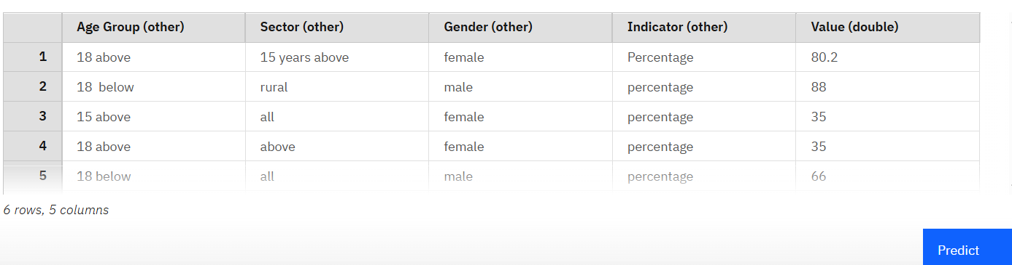
Result

Slide 10
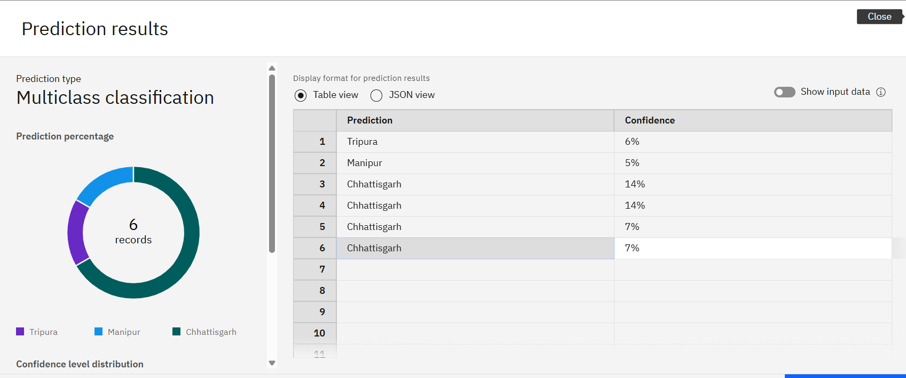
CONT

Slide 11
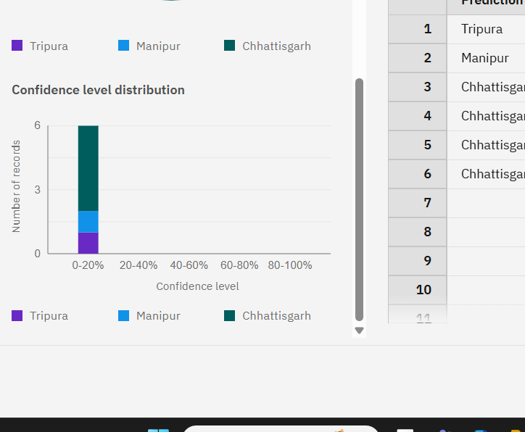
CONT
Multi-class classification model predicted Indian states based on water quality indicators and demographics, with low confidence suggesting data imbalance. Highest water access seen in rural males under 18 (88%), while older females showed lowest (35%). Model tuning and feature engineering recommended to improve accuracy.

Slide 12
Conclusion
The project highlights critical disparities in access to improved drinking water across various states, sectors, age groups, and genders in India.
Data analysis reveals that rural areas and certain social groups still face significant challenges in accessing safe drinking water.
The insights generated from this study can support evidence-based policymaking and targeted resource allocation.
This work aligns with the goals of Sustainable Development Goal 6 (Clean Water and Sanitation) and can help monitor India's progress toward achieving equitable access to water.

Slide 13
Future scope
Scalability Across Regions:
The model can be expanded to include more granular data (district/village level), allowing policymakers to target interventions more effectively.
It can also be adapted for other countries with similar demographic and water access issues.
Integration with Real-Time Data:
The model can be integrated with IoT or smart sensors in the future to receive real-time water quality and availability data, enhancing prediction accuracy.
Real-time alerts can help authorities act promptly in regions showing signs of water scarcity.
Policy and Planning Tool:
Government agencies and NGOs can use the model’s insights to design water distribution systems and plan infrastructure development.
It can help prioritize high-risk areas for urgent attention.
Personalized Recommendations:
With further development, the model could offer tailored recommendations based on demographics (e.g., rural elderly women) who may be more affected by poor water access.

Slide 14
CONT
Machine Learning Model Enhancement:
With additional data and training, the model’s accuracy can be improved using advanced algorithms like ensemble models or deep learning.
Features like seasonality, climate data, or economic indicators could also be added for better predictions.
Public Dashboard & Awareness:
A user-friendly dashboard could be developed for public access, enabling citizens to understand water accessibility in their areas.
This increases public awareness and encourages local-level action.
Support for SDG Goals:
Aligns with the United Nations Sustainable Development Goal 6: Clean Water and Sanitation.
Can help track progress toward ensuring universal and equitable access to safe and affordable drinking water.

Slide 15
References
Ministry of Jal Shakti, Government of India. National Drinking Water Program – Survey Reports. https://jalshakti-ddws.gov.in
IBM Watsonx Platform – Official Documentation. https://www.ibm.com/products/watsonx
IBM Cloud – AI and Machine Learning Services. https://cloud.ibm.com
AI Kosh Dataset Link –
https://aikosh.indiaai.gov.in/web/datasets/details/improved_source_of_drinking_water_ multiple_indicator_survey_78th_round.html
Scikit-learn Documentation (for classification model reference). https://scikit-learn.org/stable/
GIT-HUB Link
https://github.com/Lokesh-001-tech/IBM-Cloud-Project

Slide 16
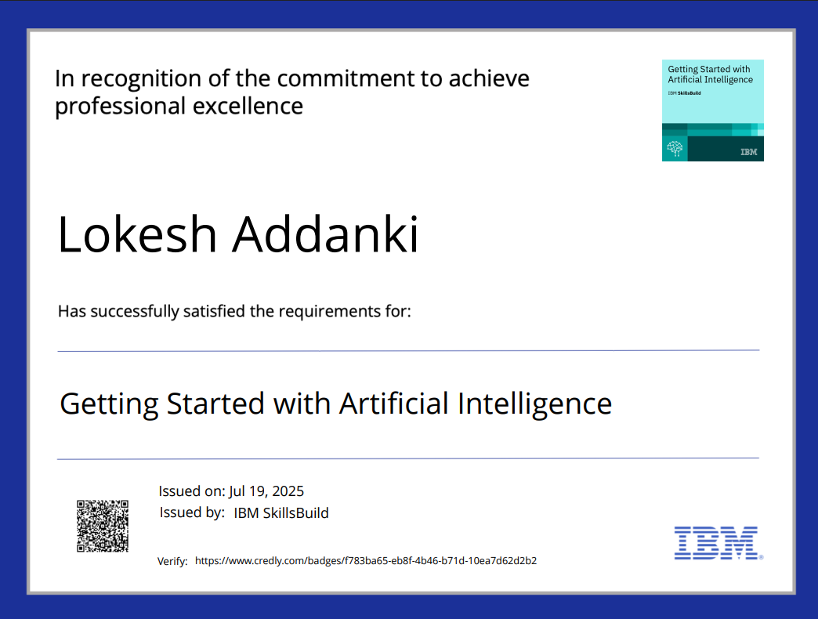
IBM Certifications

Slide 17
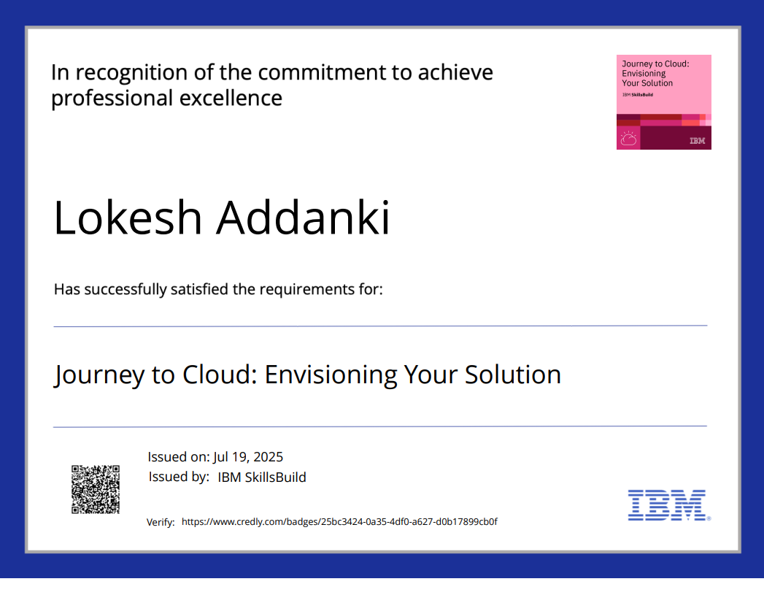
IBM Certifications

Slide 18
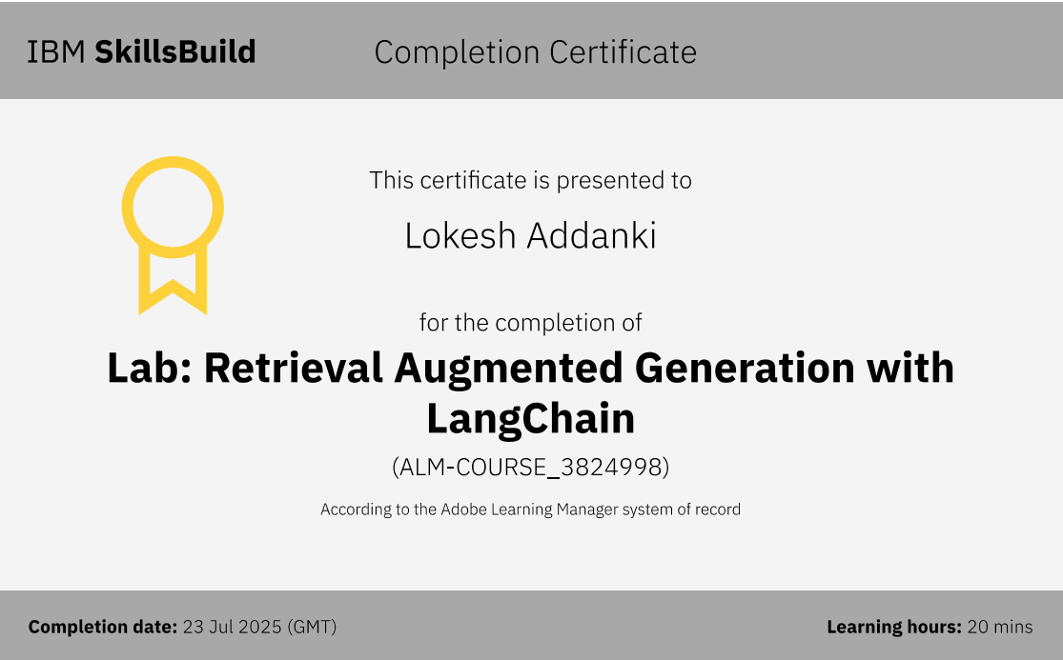
IBM Certifications

Slide 19
THANK YOU

